Slide 1
An Introduction to the R Programming Language
Lesson 1
Intro to R and R Studio

Slide 2
Getting Oriented to R

Slide 3
Lesson Goals
Get oriented to R and RStudio
Learn some fundamentals of coding
Lesson Objectives
Log in and tour RStudio Cloud
Execute code at the console
Define and use functions
Define and create objects in the environment
Load data into R and interact with a dataframe
Notes:
In this first hour our goal is to develop some familiarity with the R programming language as well as some basic proficiency with coding fundamentals as they are implemented in R.
We will log into the R environment and learn about the how to execute code in the console.
Upon this we will layer concepts of functions and objects. We will use some basic functions and make some objects.
Finally we will access and interact with a dataframe.

Slide 4
What is R?
R is a statistical programming language.
Using R you can load, analyze, and visualize data.
R also provides an environment in which we can conduct reproducible data analysis.
Documented
Revisable
Shareable
Notes:
R is a statistical programming language. It is freely available and has been evolving for > 25 years.
R is popular with statisticians and data analysts. It’s flexible, extensible, and broadly capable for the import, analysis, and visualization data.
R supports everything from linear regression to machine learning.
R also enables us to conduct reproducible analysis that we can document, iterate, and share with colleagues. R is great for those looking to graduate from working with spreadsheets.

Slide 5
RStudio: The Portal to R
RStudio is an integrated development environment (IDE)
Using RStudio we can interact with the R programming language to:
Write and execute code interactively
View data
Debug and fix errors
Author our code
Notes:
A base install of R gives us the ability to write and execute code, but working entirely at the command line isn’t intuitive or efficient.
Most R users choose to leverage an integrated development environment (IDE) for their work. An IDE layers over the R programming language and provides a more streamlined way for us to work with R.
The most popular R IDE is Rstudio. This is the IDE we will be using in this course.
Rstudio provides layers many features onto the basic R command line including the ability to easily view data, identify syntax (code grammar), and debug our code to fix errors.

Slide 6
RStudio: In the Cloud… In Your Home
RStudio Cloud: An online hosted version of RStudio that we will use for these course sessions
RStudio Desktop: A locally installed version of RStudio that you will use when you get home to continue your learning
Note: Use Rstudio Cloud only for this course. Do not upload protected health information to the cloud!
Notes:
For today’s course we plan to leverage RStudio Cloud. RStudio Cloud is an internet hosted version of RStudio which allowed us to prepare an environment and prepopulate it with data, code, and exercises so you don’t have to spend your energy on those pieces.
When you get home, you will likely transition to using a RStudio Desktop which is a locally installed version of RStudio. We suggested that you install the desktop version ahead of this course so you will be ready to continue to learning R when you walk out of the classroom this afternoon and as a fallback in the event that we experience technical challenges with the cloud deployment.

Slide 7
Your Turn
Navigate to: @@UPDATE ADDRESS
Enter your log in credentials
Join Space
Make a copy of the Core Exercises for yourself
Notes:
Let’s take a few minutes to get logged into RStudio Cloud.
In the pre-course email, we asked you to create an RStudio log in. Use those credentials now to access the instance.
The following slides show the clicks to copy the workspace.
Raise your hand if you need help.

Slide 8
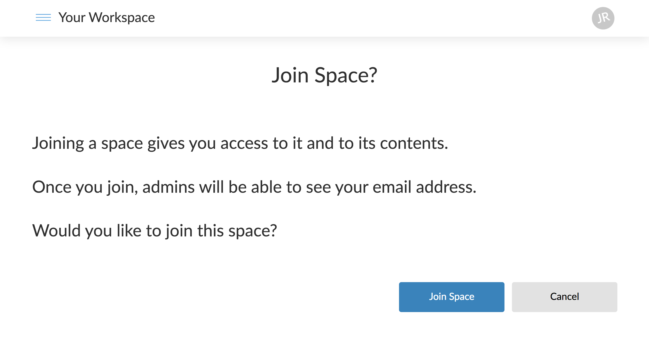
Notes:
Click “Join Space”

Slide 9
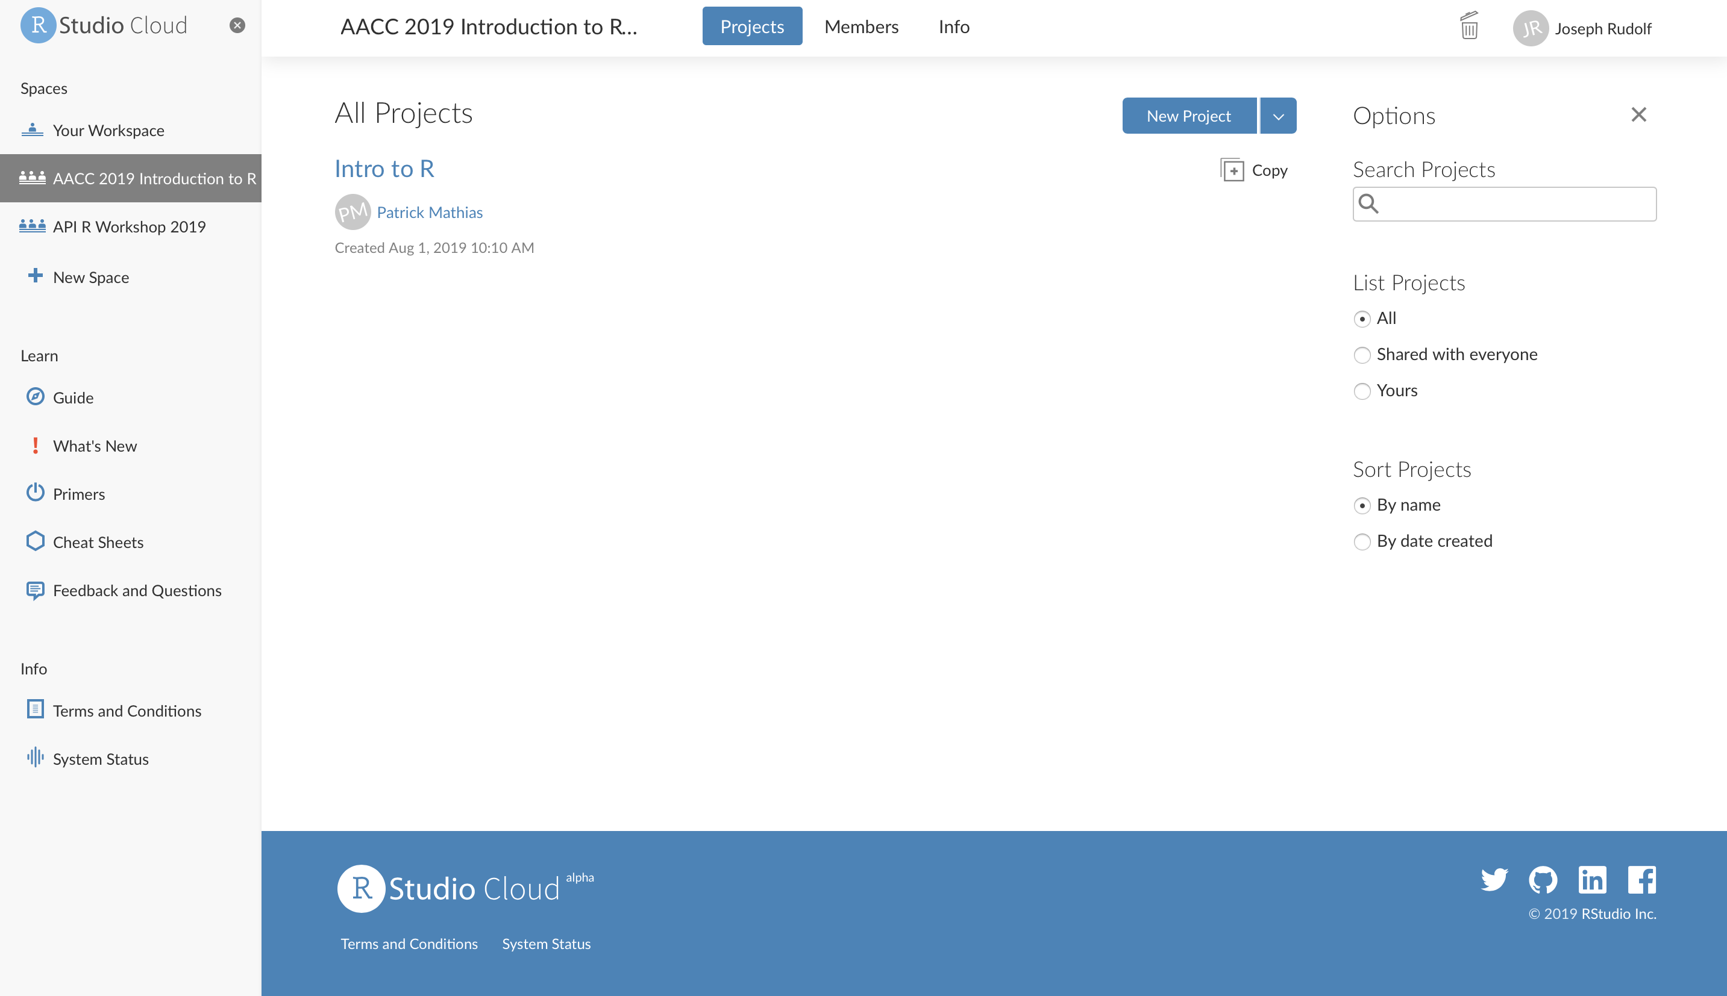
UPDATE WITH 2020 Workspace Screenshot
Notes:
Select the workspace “AACC 2019 Introduction to R Programming”
Click “Copy” to create your own version of the core course workspace.

Slide 10
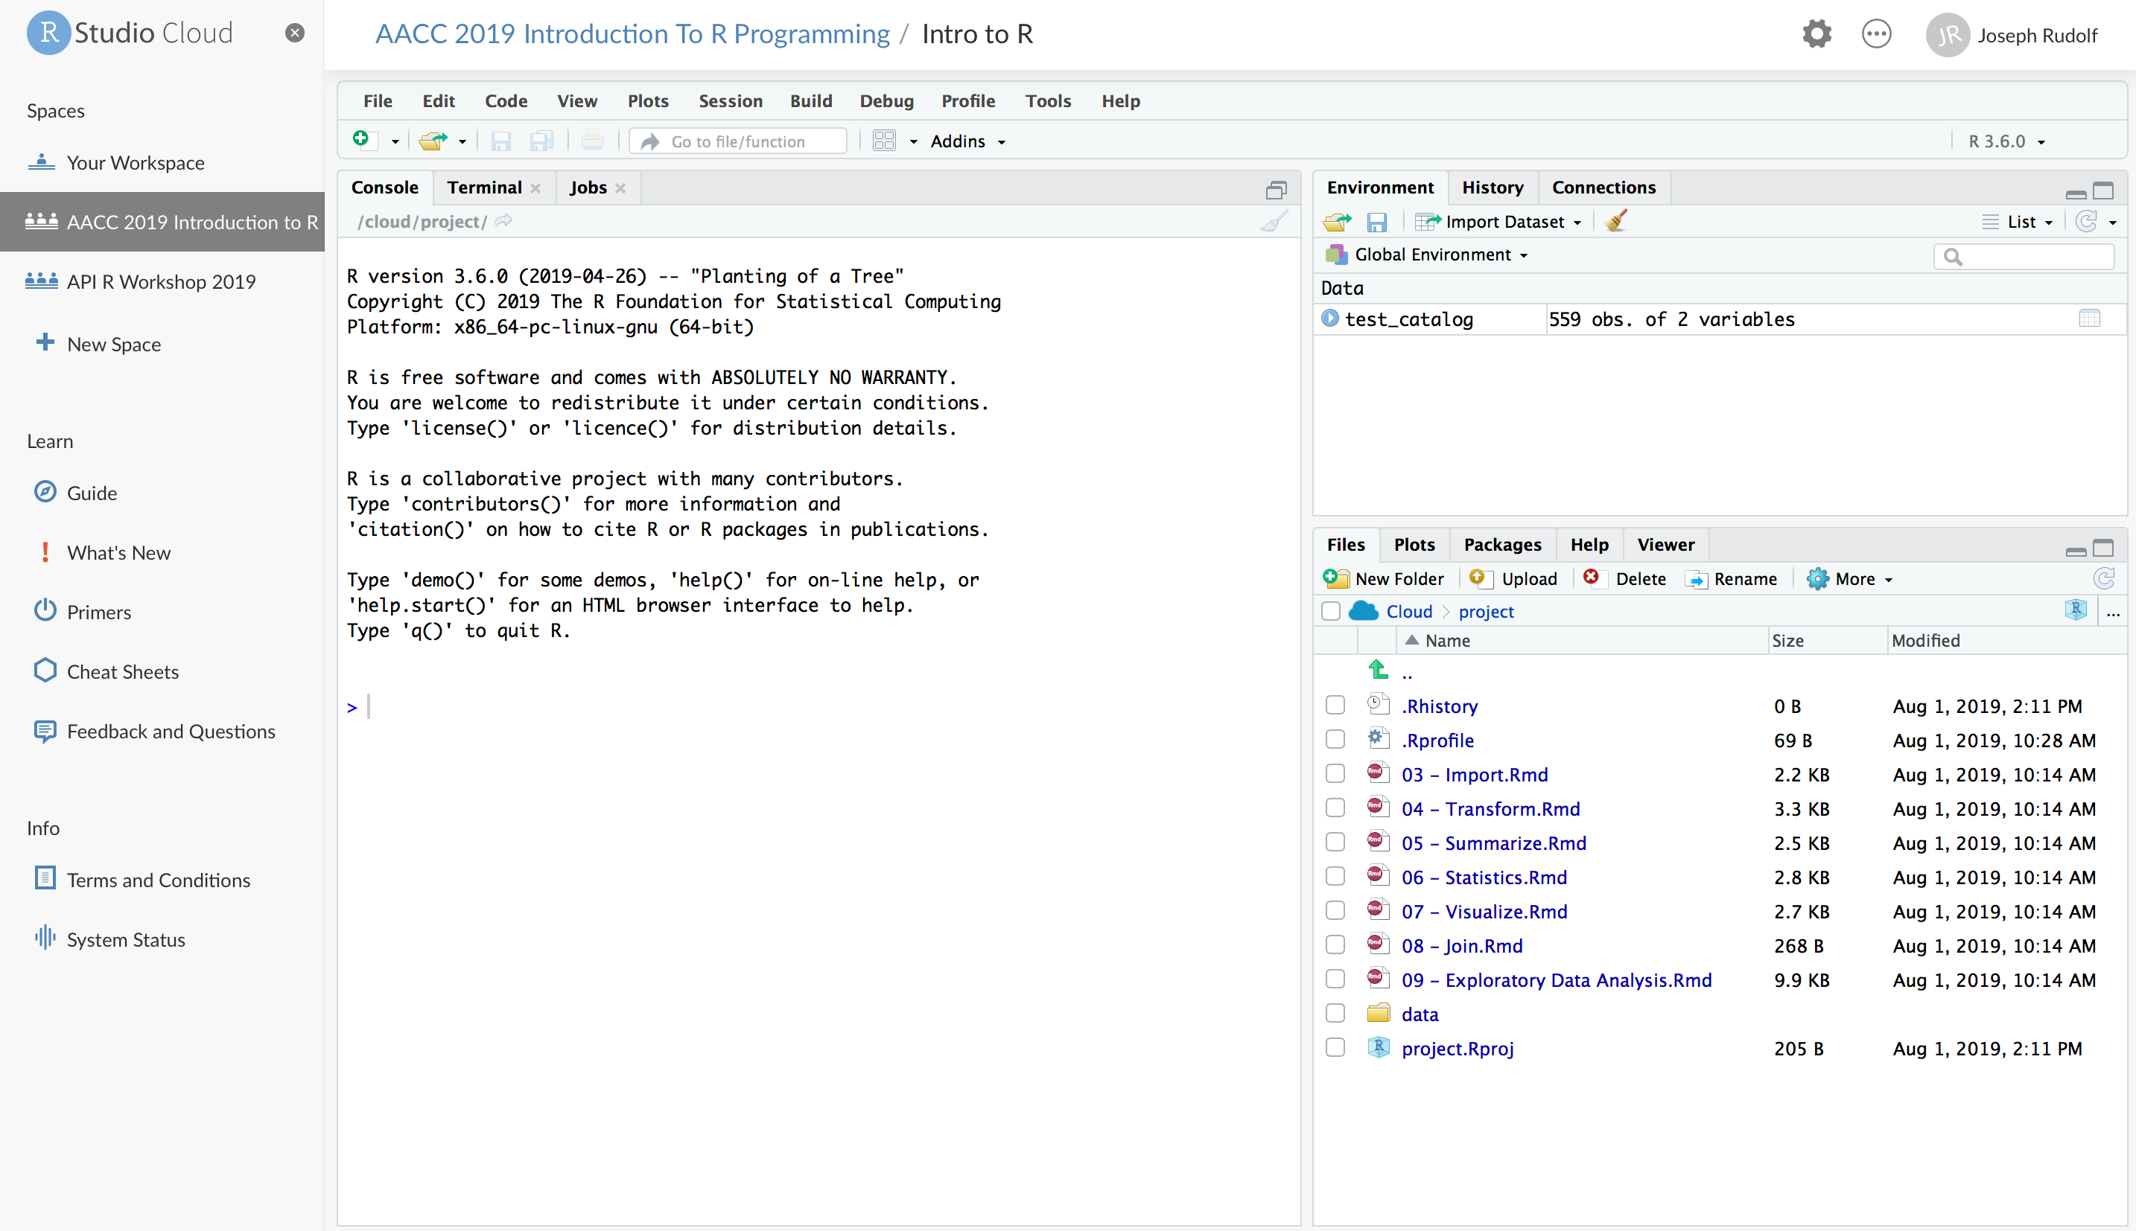
UPDATE WITH 2020 Workspace Screenshot
Notes:
Wait for for your version of the project to spin up. Your screen will look like this when the work space is finished loading.

Slide 11
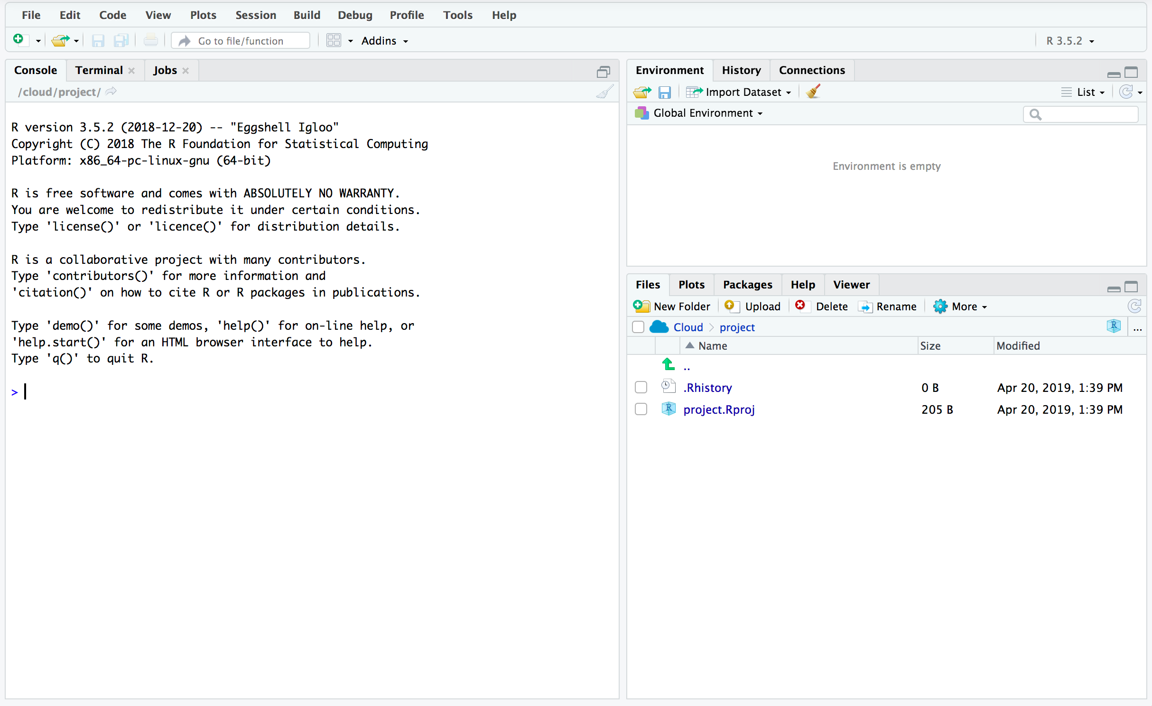
Overview of the RStudio Environment
ENVIRONMENT
CONSOLE
OUTPUT
Notes:
This is the basic RStudio layout.
Console – Where we will enter and execute the code we write in this session.
Environment – Where objects (think variables or containers for storing data) will appear.
Output – Where the output of our visualization occurs. It also has tabs for us to browse file locations and interact with the help documentation

Slide 12
The Basics of Coding

Slide 13
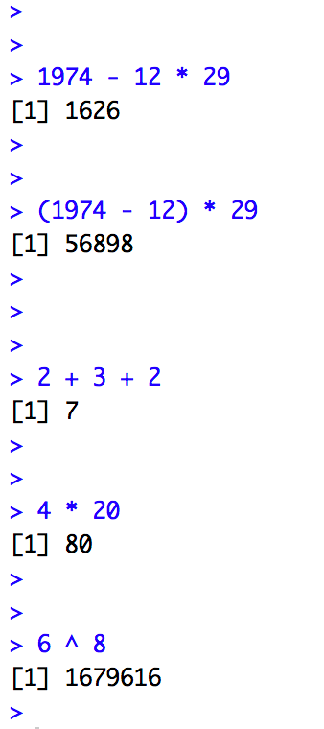
The Basics of Coding: Calculation
R is a calculator!
enter/return to execute code
answer returned here
Notes:
At it’s most basic, R is a fancy calculator.
It supports common mathematical operators
+ add, - subtract
* multiply, / divide
^ exponents
We type our code at the console and use the enter (return) key to execute.
The answer is returned on the following line.

Slide 14
Your Turn
Place your cursor at the console and click to enter the console.
Complete the following calculation:
-For the date 12-29-1974
-Take the four digit year
-Subtract the month then multiply by the day
Notes:
Now it’s your turn to do some coding.
Complete the following exercise.

Slide 15
What did you get?
A four digit number? A five digit number?
Order of operations matters!
Notes:
Let’s review our answers.
Order of operations matters
-exponents and roots first
-multiplication and division
-addition and subtraction
Multiplication will occur before subtraction unless we embed our operation in parentheses.

Slide 16
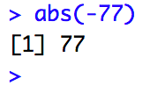
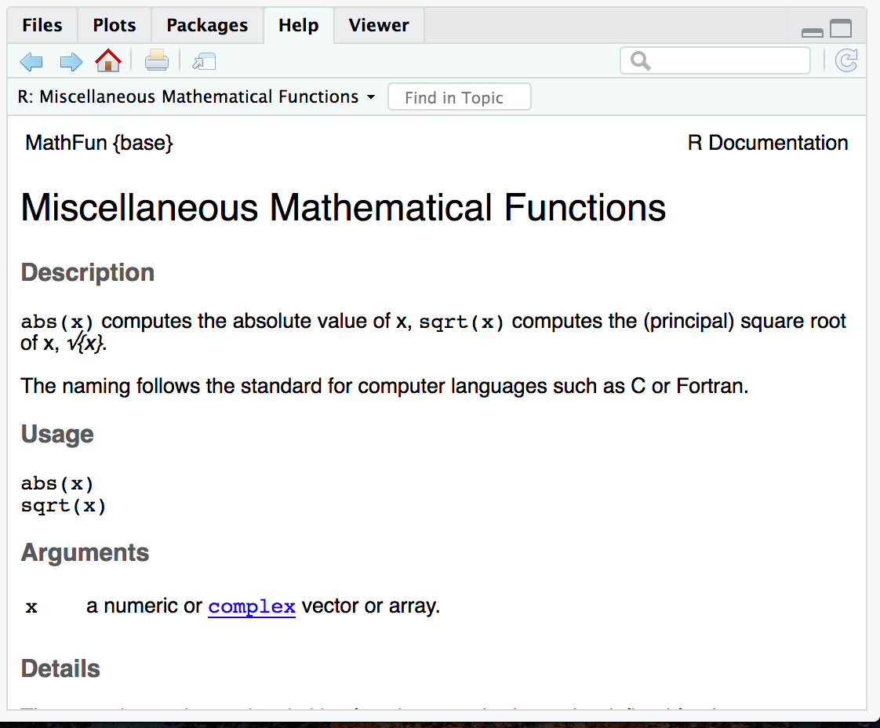
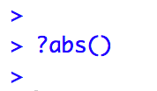
The Basics of Coding: Functions
function
(does stuff)
argument
(input)
Code that extends our reach beyond the basic operators
What if I don’t know what a function does?
abs(-77 )
Notes:
Functions are code that perform actions on our behalf. We can use functions that others have written (or that we write ourselves) to reuse existing code over and over.
Functions accept an argument (input). We use parentheses as the syntax (grammar) to identify the argument(s).
Then the function does its task and provides us with some output, in this case the absolute value of an integer.
The help feature in R is very… helpful! Preceding a function with ? and executing the line will bring up help documentation and will educate us on how to use a function.

Slide 17
Your Turn
Launch the help function for seq() using help (?)
Read about the seq() function in the output window
Can you describe what the seq() function does?
Notes:
Now it’s your turn to learn about a function.
Use the help feature to read about the seq() function.
What does the seq() function do?

Slide 18
When you need more help
The Internet (Stack Overflow: https://stackoverflow.com/)
Work Aids (RStudio Cheat Sheets: https://www.rstudio.com/resources/cheatsheets/)
A Good Book (R for Data Science: http://r4ds.had.co.nz/)

Slide 19
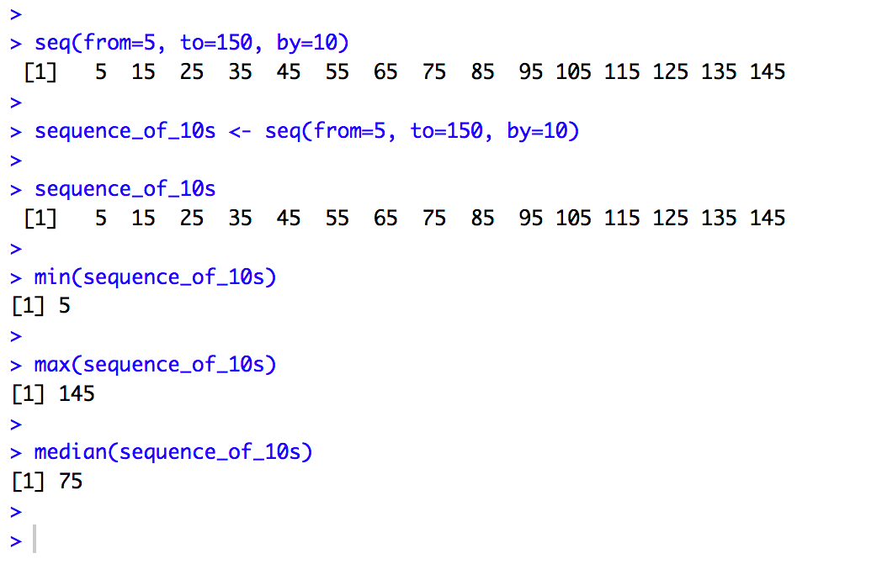
Putting Functions to Work
We can use functions to do more than simple math, we can make things!
We can create a series of integers (a vector) using the seq() function
Notes:
Functions can do more than simple math.
In this case the sequence function seq() accepts arguments defining a start position, a stop position, and an interval, to create a series (a vector) of integers.

Slide 20
The Basics of Coding: Objects
Objects are the vessel for your output
object
(stores output)
function
(does stuff)
arguments
(input)
sequence_of_10s <- seq(from=5, to=150, by=10 )
Notes:
Objects are a very important concept in many programming language.
Objects are the containers in which we can store things for later use.
You can store single values, series, tables, or even names.
In this example we are taking our previous seq() created series and storing it out to an object which we have called sequence_of_10s.
The <- characters are called an assignment operator. They point to the place where we want to store output.

Slide 21
Checking the Contents of an Object
Entering the object name at the console allows us to output the contents of an object.
Notes:
We can call our object at the console by typing the object name and pressing enter/return.

Slide 22
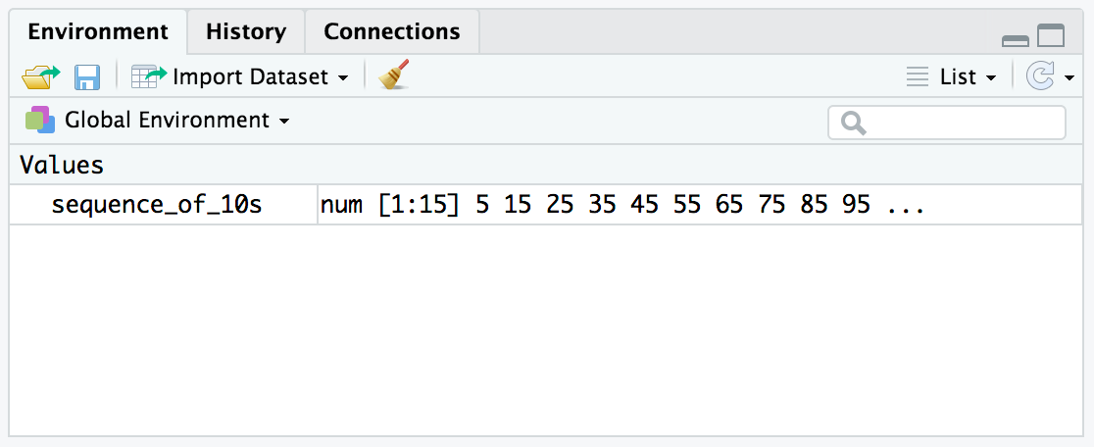
Checking the contents of an object
The environment tab shows us the objects we have created.
Notes:
We can also review our object in RStudio via the environment tab.
When we create an object in the environment, it will appear in the environment tab and we can review its contents there.

Slide 23
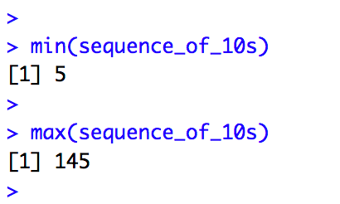
Bending objects to your will
Once we have created an object we can start to interact with it.
This includes passing our objects to other functions… Whoa!
Notes:
Objects are subject to same laws of programming we have learned so far.
We can provides objects as arguments for functions.

Slide 24
Your Turn
Generate a sequence, store it to an object, and ply your object*
-use the seq() function to create a vector from 0 to 500 by 25.
-assign your sequence to an object called sequence_of_25s
-check the contents of your object (at the console and in the environment tab)
-use the median() function to find the median value of your vector
*Use the help (?) feature if you get stuck

Slide 25
The Basics of Coding: Packages
A package is a collection of functions.
Packages extend the capabilities of the base R programming language.
The tidyverse includes functions for reading data into the R environment, cleaning and manipulating data, and plotting our results.
Notes:
Packages are collections of functions that extend the capabilities of R. They are written and published by members of the R community.
Packages are hosted on The Comprehensive R Archive Network [CRAN] at https://cran.r-project.org/. There are are 10,000 packages in CRAN, wow!
The tidyverse is an example of a package. It includes specialized functions for reading data, cleaning, data, performing analysis, and visualizing results.
We will make extensive use of the tidyverse in today’s course and encourage you to use it in your own work.

Slide 26
Installing and Loading Packages
Installing a package
Loading into your environment
function
(does stuff)
arguments
(input)
install.packages("tidyverse", dependencies = TRUE)
library(tidyverse)
Notes:
To install packages we use a function called install.packages().
The principal argument for this function is the name of the package, in this example ”tidyverse”.
No need to install this package! It is pre-installed for you in RStudio Cloud. However, if you are using a desktop install of RStudio (now or in the future) you will need to install this package.
When we want to call functions from the tidyverse into our analysis, we need to load the package. We use the library() function.

Slide 27
Importing Data and Working with Dataframes (aka Useful Data)
Notes:
Vectors are useful, dataframes are even more useful and most closely represent the data we know and love!

Slide 28
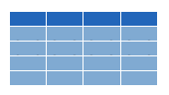


Dataframes: Beyond the Vector
Dataframe is the term for a table
Dataframes are composed:
Columns (Variables)
Rows (Observations)
Dataframes are objects and can be acted on like other objects
csv
xls
db
Notes:
Dataframe is the term we use for a table (think Excel spreadsheet).
Dataframes consists of columns (variables) and rows (observations). This is the tidy way to organize our data.
We can store dataframes as objects and perform actions on them like other objects.
We can get data into R from a variety of file formats (comma separated value files, excel spreadsheets, or directly from databases). This is the import part of data analysis. We will get to importing data in the next hour. For now let’s work with an object that we have prepopulated in the cloud environment.

Slide 29
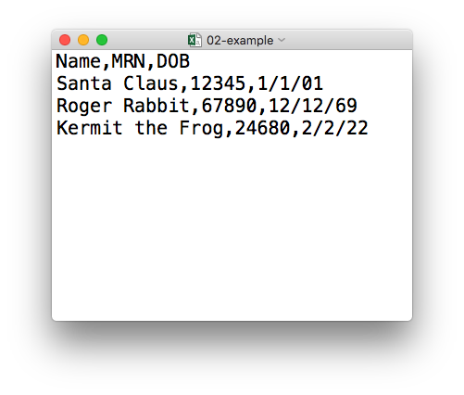
plain text (“flat”) file
rectangular structure
header row
csv
Notes:
So what’s a CSV file? CSV stands for comma-separated values.
* A CSV file is a plain text file, which means you can open it in a text editor and look at it.
Here we have a CSV file with the names, MRNs, and date of birth of three “patients”
* This data structure is called rectangular because it falls into rows and columns, where each row has the same # of columns, and each columns has the same # of rows.
* Also note that this particular CSV file has a header row that, instead of data, has a descriptor of what kinds of data are found in each column. CSV files often but not always have such a header row.

Slide 30

Loading Data to Create a Datafram
data_frame <- read_csv(file_name)
csv
Notes:
You can import CSV files using the read_csv() function. Here is a template for how to use the read_csv function to create a data frame object from a CSV file. You start with the name of a data frame object then you have this left-ward arrow then read_csv and then the file name in parentheses.
Let’s look at a simple dataframe that we have preloaded into the environment.
In our environment tab you will find an object called test_catalog. This object is derived from a larger data set we will be using for the remainder of the course.
We can single click this object to visualize its contents.

Slide 31
Function Sytanx Review
object
(stores output)
function
(does stuff)
argument
(input)
data_frame <- read_csv(file_name)
assignment operator
(“gets”)
Notes:
To put the output of the read_csv function into a named object, you use the assignment operator.
The assignment operator is a smaller-than followed by a dash or minus and looks kind of like an arrow pointing left. It’s usually read as “gets.”

Slide 32
Your Turn
Load the Covid Testing CSV:
-Use the read_csv() function
-file_name argument: “data/covid_testing.csv”
-object name: covid_testing
Notes:
Your turn again!
Let’s use our knowledge of the head() function and apply it to the end of the table using the tail() function.

Slide 33
read_csv()
data frame to read data into
name of
CSV file
covid_testing <- read_csv(”data/covid_testing.csv")
covid_testing
covid_testing.csv
csv
Notes:
So, for example in this line of code the object test_df gets a data frame created by read_csv as it reads a file named test_data.csv.
The line reads “test_df gets read_csv of test_data.csv.”
You might notice that one of the objects is put in quotes and the other one isn't.
To be honest, quotes can be confusing. Names of objects such as data frames don't get quotes. In contrast, literal file names are always put in quotes.

Slide 34
What’s in a name?
Capitalization matters
Strive for names that are concise and meaningful (not easy!)
covid_testing
≠
Covid_testing
≠
COVID_TESTING
Bad
Still not great
Good
p
name
patient_name
Notes:
You might have also noted that we created a new named object, test_df, and ask yourself, how should I decide how to name things.
…
If you have something that represents patient names, …
I personally recommend keeping all of your object names (data frames and columns of data frames) all lower case, with underscores between words, like patient_name. Also try to stay consistent.

Slide 35
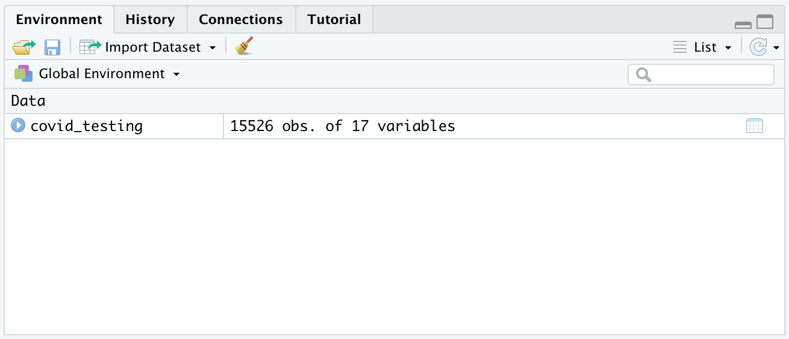
Viewing the Contents of a Dataframe
single click to explore the data
Notes:
Let’s look at a simple dataframe that we have preloaded into the environment.
In our environment tab you will find an object called test_catalog. This object is derived from a larger data set we will be using for the remainder of the course.
We can single click this object to visualize its contents.

Slide 36
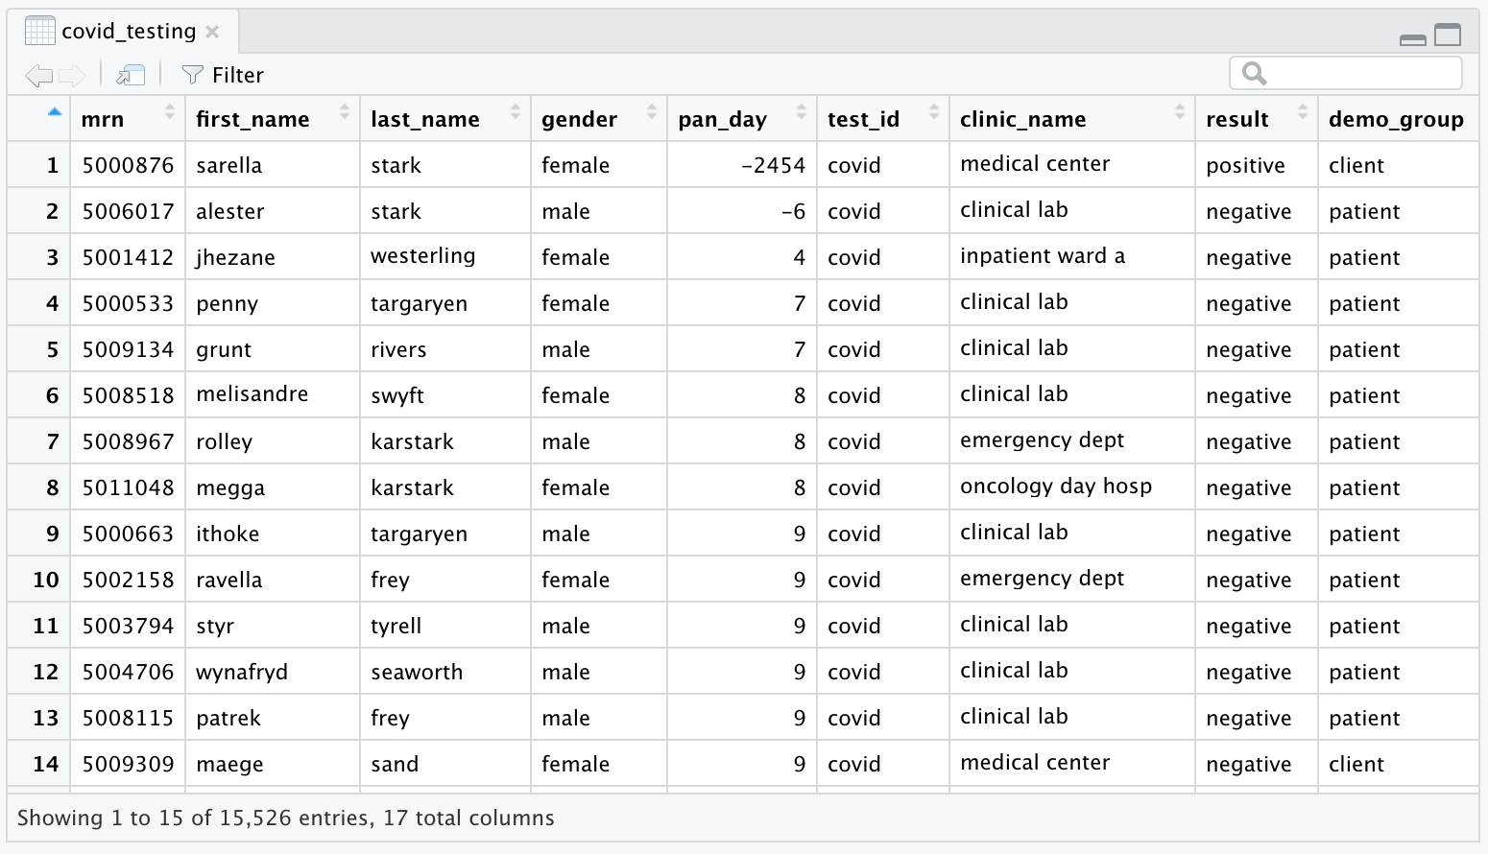
Viewing the Contents of a Dataframe
17 Attributes (Columns)
15,526 Observations (Rows)
Notes:
This data frame consists of 2 attributes and 559 observations.
The variables are a description (test name) and proc_code (test code).
After exploring the data in the dataframe we can close it by selecting the “x” in the tab at the top left of the pane.

Slide 37
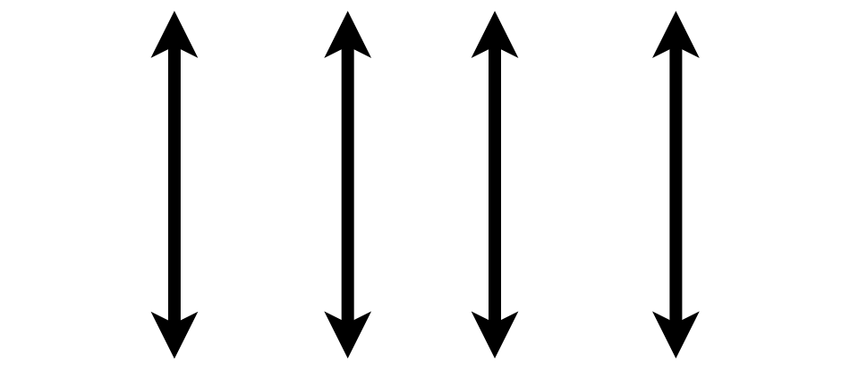

What is a “Tidy” Dataframe?
A data set is tidy if:
Each variable is in its own column
Each observation is in its own row
Each value is in its own cell
Notes:
This is a good time to review the idea of ”tidy” data that also gives the “tidyverse” its name.
Any data set can take on a lot of different shapes. But there is one shape that is best suited for data analysis, and that shape is called ”tidy.”
The opposite of “tidy” data is often called “messy” and often times one of the first data analysis tasks is to convert “messy” data into “tidy data.”
A data set is tidy if: each variable is in its own column,
Each observation is in its own row
Each value is in its own cell

Slide 38
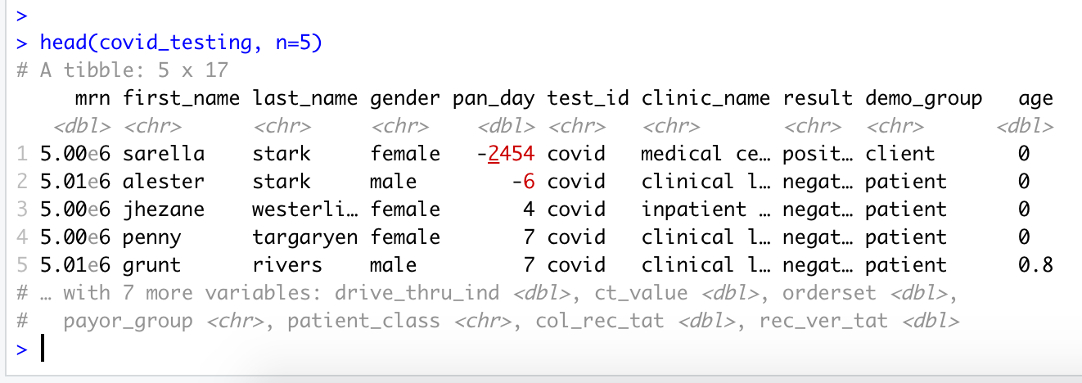
Working with Dataframes at the Console
The head() function is helpful for displaying a snippet of your dataframe
head(object_name, n=number of rows to view)
Sample of Data in Your Object
Notes:
As your data sets grow in size and complexity, the environment tab becomes unwieldly for interacting with objects.
For speed and efficiency, you can render a quick looks at your dataframe using the head() function. The arguments for this function are the name of the object, and the number of rows you want to view, in this example we asked for the top 5 rows of the data frame.

Slide 39
Your Turn
Understanding Object Contents
-Use the tail() function to view the last 10 rows of our object covid_testing.
-What is the ratio of female to male patients in this subset of data?
-What are the youngest and oldest patient ages in this subset of data?
Notes:
Your turn again!
Let’s use our knowledge of the head() function and apply it to the end of the table using the tail() function.

Slide 40
Console… I only just knew you
As the complexity of our coding increases, the ability to iterate our lines of code as we write becomes apparent
We find it increasing difficult to manage the names and states of objects in our environment
And the console shows us its limitations
Notes:
This is a relatively straightforward analysis, but even this is unwieldly to develop at the console.
It’s easy to get confused about which objects you have created and what their contents are when developing at the command line. It’s also easy to accidentally overwrite the contents of an object without realizing it, further muddying the environment.
Within a couple hours of learning to program in R, you may start to get frustrated with the command line.

Slide 41

A Hero is Born
Hi! My name is Mark Down and I am here to save earth from non-reproducible reporting.
Notes:
Luckily there is a better way!
And this is what we will explore in the second hour.
But first let’s take a couple minutes to stretch. You’ve earned it!

Slide 42
END OF PRESENTATION FOLLOWING SLIDES FOR STAGING

Slide 43
Importing Data

Slide 44
Why bother?
csv
Data frame
xls
db
Notes:
Every data analysis starts with data, and that data is stored primarily in two ways: in files on your computer’s hard drive; or in online databases.
Before R can manipulate data, you need to load it into R’s memory. This is a process called Importing or Reading.
* The most common scenarios in clinical data analysis are importing data from a CSV file, an Excel file, or directly from a database. The data will then exist in R’s memory as an object called a “data frame”

Slide 45
plain text (“flat”) file
csv
rectangular structure
header row
Notes:
So what’s a CSV file? CSV stands for comma-separated values.
* A CSV file is a plain text file, which means you can open it in a text editor and look at it.
Here we have a CSV file with the names, MRNs, and date of birth of three “patients”
* This data structure is called rectangular because it falls into rows and columns, where each row has the same # of columns, and each columns has the same # of rows.
* Also note that this particular CSV file has a header row that, instead of data, has a descriptor of what kinds of data are found in each column. CSV files often but not always have such a header row.

Slide 46
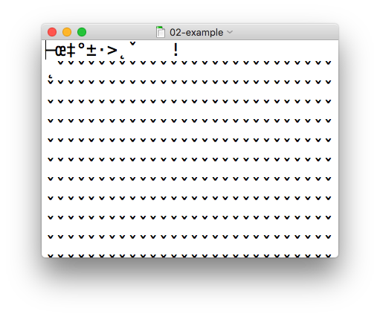
csv
xls
Notes:
In contrast, an Excel file is written in a binary format that looks like a jumbled mess when you try to load it in a text editor.
The good news is, R is perfectly capable of loading both CSV and Excel files.

Slide 47
Import flat rectangular data files (.csv, .tsv, ...)
library(readr)
Alternatively,
library(tidyverse)
Notes:
We’ll be using the readr package, which is part of the tidyverse, to read a CSV file.
Remember that to load a package you use the library() command. In this case you’ll want to load the readr package.
* It’s also OK to load the tidyverse package. The tidyverse package is what's called a *meta-package*. A meta-package doesn't actually contain any data or functions by itself but rather makes R pull in a predefined set of other packages. So running library(tidyverse) loads readr and a couple of other packages that frequently used together for data analysis and visualization.

Slide 48
read_csv()
data_frame <- read_csv(file_name)
csv
Notes:
You can import CSV files using the read_csv() function. Here is a template for how to use the read_csv function to create a data frame object from a CSV file. You start with the name of a data frame object then you have this left-ward arrow then read_csv and then the file name in parentheses.

Slide 49
Aside: R Syntax Basics
object
(stores output)
function
(does stuff)
argument
(input)
data_frame <- read_csv(file_name)
assignment operator
(“gets”)
Notes:
To put the output of the read_csv function into a named object, you use the assignment operator.
The assignment operator is a smaller-than followed by a dash or minus and looks kind of like an arrow pointing left. It’s usually read as “gets.”

Slide 50
read_csv()
data frame to read data into
name of
CSV file
test_df <- read_csv("test_data.csv")
test_df
test_data.csv
csv
Notes:
So, for example in this line of code the object test_df gets a data frame created by read_csv as it reads a file named test_data.csv.
The line reads “test_df gets read_csv of test_data.csv.”
You might notice that one of the objects is put in quotes and the other one isn't.
To be honest, quotes can be confusing. Names of objects such as data frames don't get quotes. In contrast, literal file names are always put in quotes.

Slide 51
Aside: Naming Things
Capitalization matters
Strive for names that are concise and meaningful (not easy!)
test_df
≠
Test_df
≠
TEST_DF
Bad
Still not great
Good
p
name
patient_name
Notes:
You might have also noted that we created a new named object, test_df, and ask yourself, how should I decide how to name things.
…
If you have something that represents patient names, …
I personally recommend keeping all of your object names (data frames and columns of data frames) all lower case, with underscores between words, like patient_name. Also try to stay consistent.

Slide 52
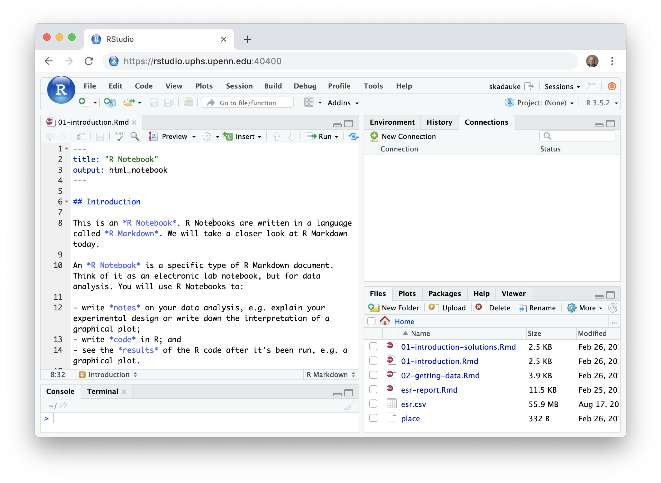
Notes:
Does everyone see this screen when logged in?

Slide 53
Working with Dataframes at the Console
The summary() function provides you with some abbreviated metadata about your dataframe.
summary(object_name)
Number of Observations (Rows)
Attributes (Columns)
Data Type
Notes:
There are also functions which allow us to quickly explore a dataframe.
If we provide an object name as an argument to the summary() function, we can quickly learn about the attributes in our data set, the number of observations, and they data type of the attribute (more to come on data types later in the course).

Slide 54
Taking the Leap to Visualization

Slide 55
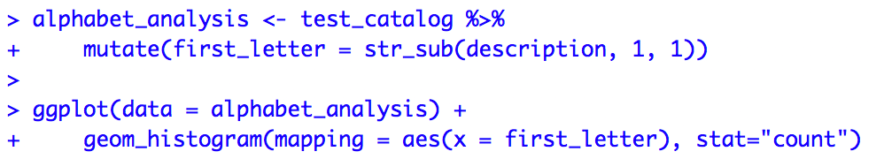
Even Simple Dataframes Can Be Interesting
With a few lines of code we can turn our test catalog…
Identify First Letter in the Test Name
Make a histogram of the Data
Notes:
This is a very simple dataframe but can still yield interesting observations.
With a few lines of code we can render a visualization of our dataframe.
Don’t worry about the details of the syntax at this point, we will unpack these functions and concepts (rename(), ggplot(), etc.) throughout the day.
This code takes our test_catalog, isolates the letter that the test names start with, counts the test names by their first letter, and outputs a bar plot of the analysis.
One quick syntax tip: the $ symbol specifies a column from a dataframe in the following format: dataframe$column.

Slide 56
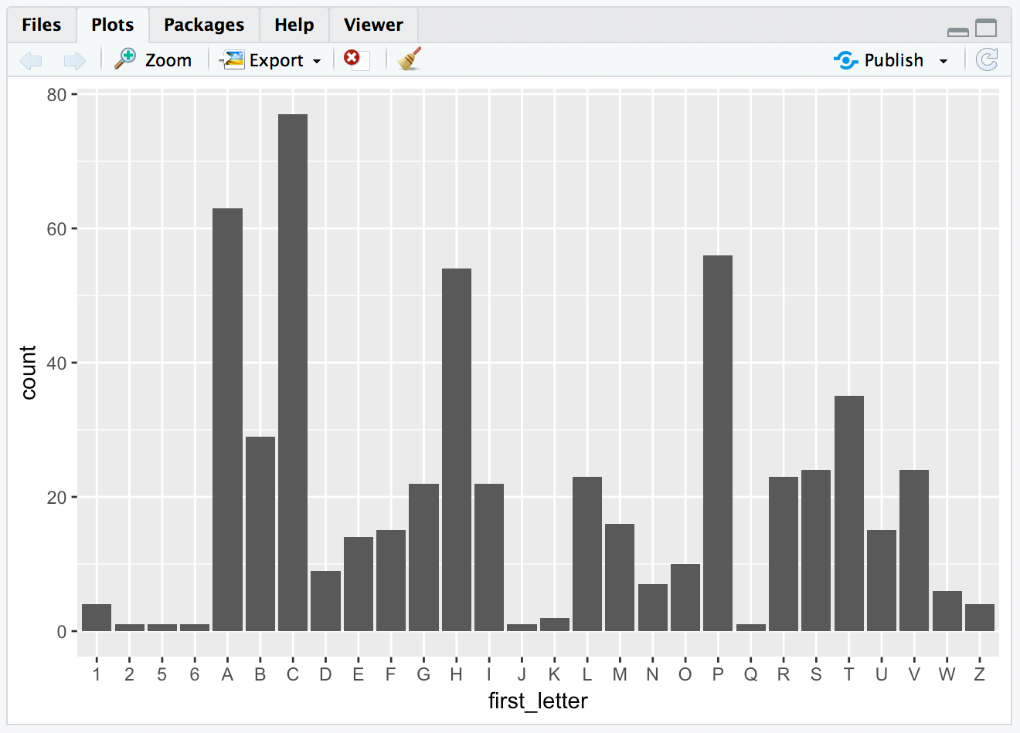
Into an insightful visualization
Notes:
Our bar plot appears in the environment tab.
In our test_catalog, test names commonly start with the letters “C”, “A” and “P”, and very infrequently with letters like “Q”, “J” and numbers. That makes sense!

Slide 57
Your Turn #5
Install a package and load it into the environment
-Leverage the install.packages() function to install a package called ”janitor”
-Load the package into your environment using the library() function.
Notes:
Now it’s your turn to install a package.
Let’s install a package called “janitor” which we will make use of later in the course.
After installation, load the package into your environment with the library() function.
If you have some time after installing the package you can read about it’s function using the help command ??.

Slide 58
Import flat rectangular data files (.csv, .tsv, ...)
library(readr)
Alternatively,
library(tidyverse)
Notes:
We’ll be using the readr package, which is part of the tidyverse, to read a CSV file.
Remember that to load a package you use the library() command. In this case you’ll want to load the readr package.
* It’s also OK to load the tidyverse package. The tidyverse package is what's called a *meta-package*. A meta-package doesn't actually contain any data or functions by itself but rather makes R pull in a predefined set of other packages. So running library(tidyverse) loads readr and a couple of other packages that frequently used together for data analysis and visualization.

